Slide 1


Slide 2
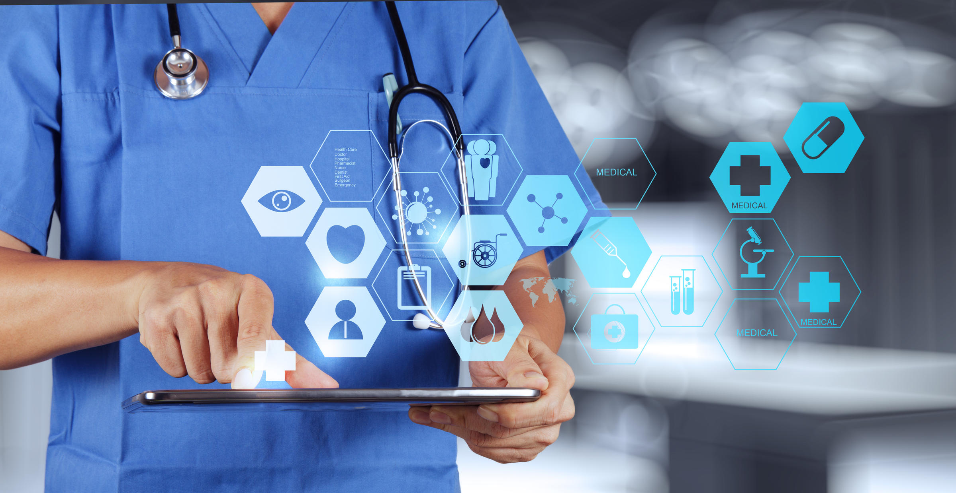
Automated Classification Toolkit for Medical Imaging Researchers
Supervised By: Dr. Mudassar Raza
Presented By: Usman Asim & Sami Ullah

Slide 3
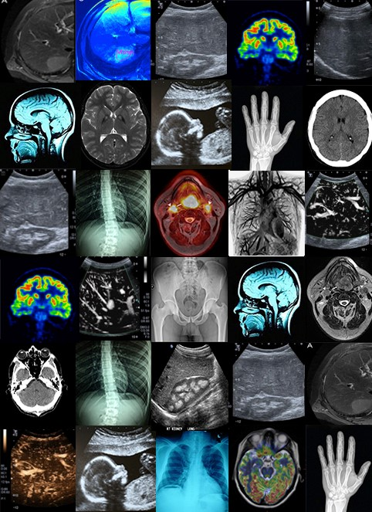
Outline
Abstract
Introduction
Literature Review
Proposed Methodology
Conclusion and Results

Slide 4
Outline
Abstract
Introduction
Literature Review
Proposed Methodology
Conclusion and Results

Slide 5
Abstract
Machine learning is very important in digital images processing field
It plays an important role in medical field.
In this work, we have created a toolbox, to help the researchers to apply different machine learning algorithms on medical images, to make the predictions and take results on the different kind of medical images dataset.

Slide 6
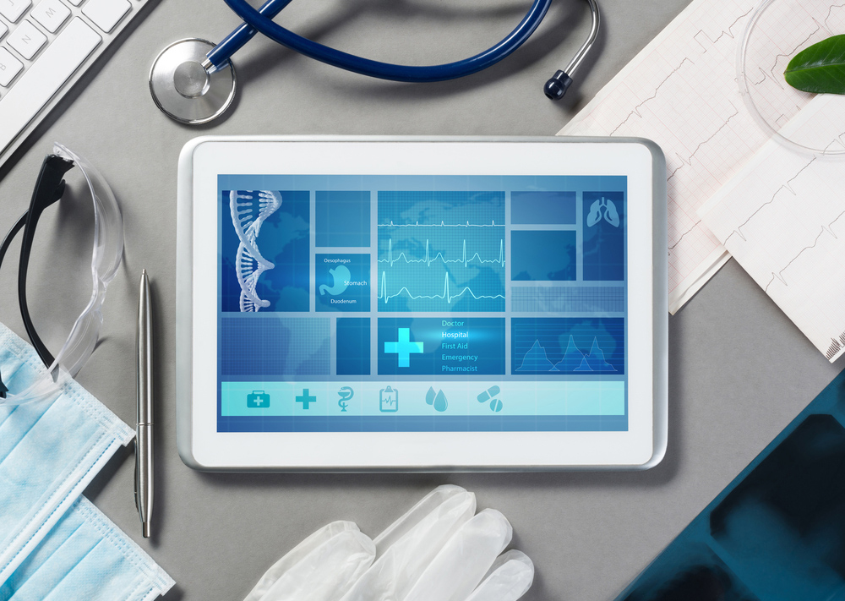
Outline
Abstract
Introduction
Literature Review
Proposed Methodology
Conclusion and Results

Slide 7
Introduction
Machine learning is a technique for patterns recognition.
It is a powerful tool that can help in rendering medical diagnoses.
There is no GUI tool available for that purpose of applying the machine learning techniques on medical images.
That’s why we created a toolkit for preprocessing, features extraction, training, testing the classifiers and getting the results.
It can load the different datasets and apply different combinations of techniques on medical imaging datasets.

Slide 8
Outline
Abstract
Introduction
Literature Review
Proposed Methodology
Conclusion and Results

Slide 9
Literature Review
In medical field the most dangerous disease is cancer.
There are more than 100 types of cancer, including breast cancer, skin cancer, lung cancer etc.
Several toolkits are exist in literature.
All the toolkits performs the specific task.
These toolkits are not open source applications.
Ilastik: Interactive learning and segmentation toolkit [1] performs the segmentation on specific type cancer.
Ballabio et al. [2] only work on numeric datasets not on images dataset.

Slide 10
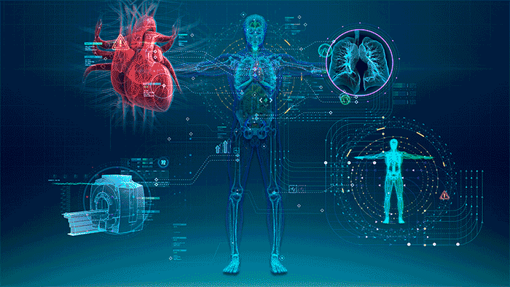
Outline
Abstract
Introduction
Literature Review
Proposed Methodology
Conclusion and Results

Slide 11
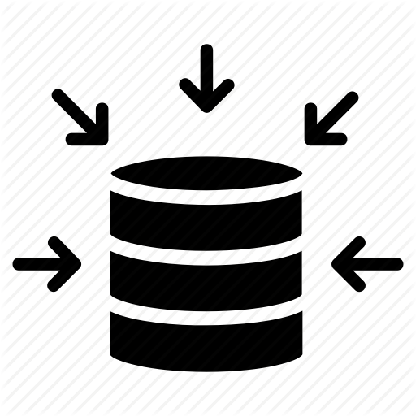
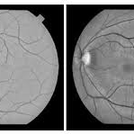
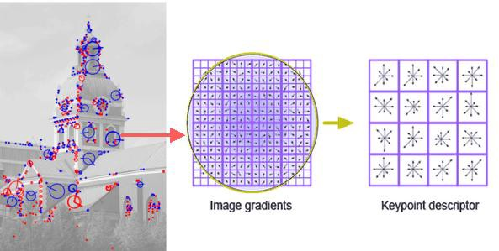
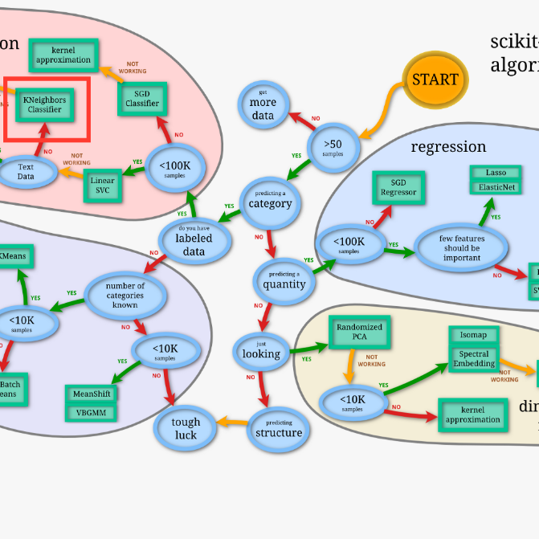
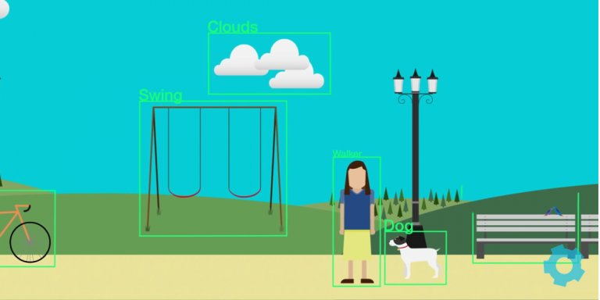
Proposed Methodology
Data Loading
Preprocessing
Features Extraction
Training
Testing
Load the Dataset from the computer
Apply different filters and segmentation techniques
Extract the features of different type and apply fusion on them
Trained the selected model by user
Test the accuracy

Slide 12
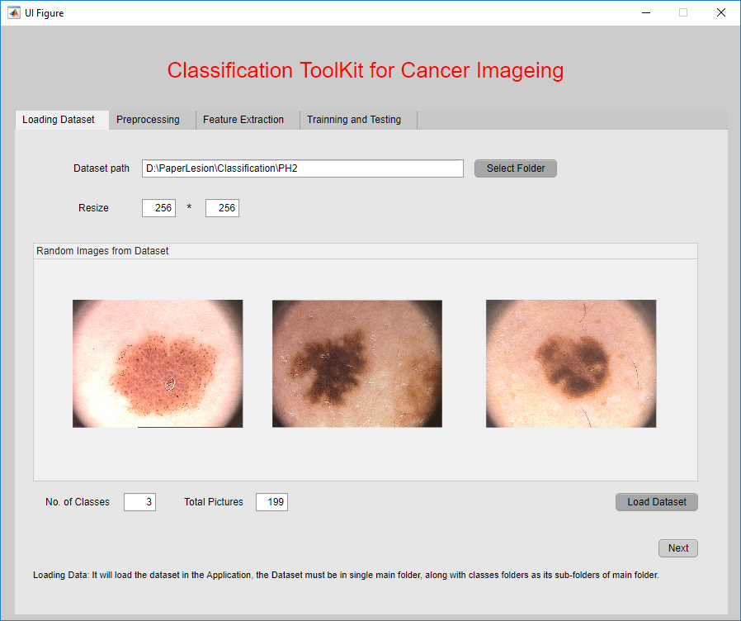
1 . Data Loading
Data Loading
Selecting the dataset folder by user placed in Laptop.
It will tells us the total number of instances and total number of classes in the Dataset.
Also we can give the picture size if need to resized the data.

Slide 13
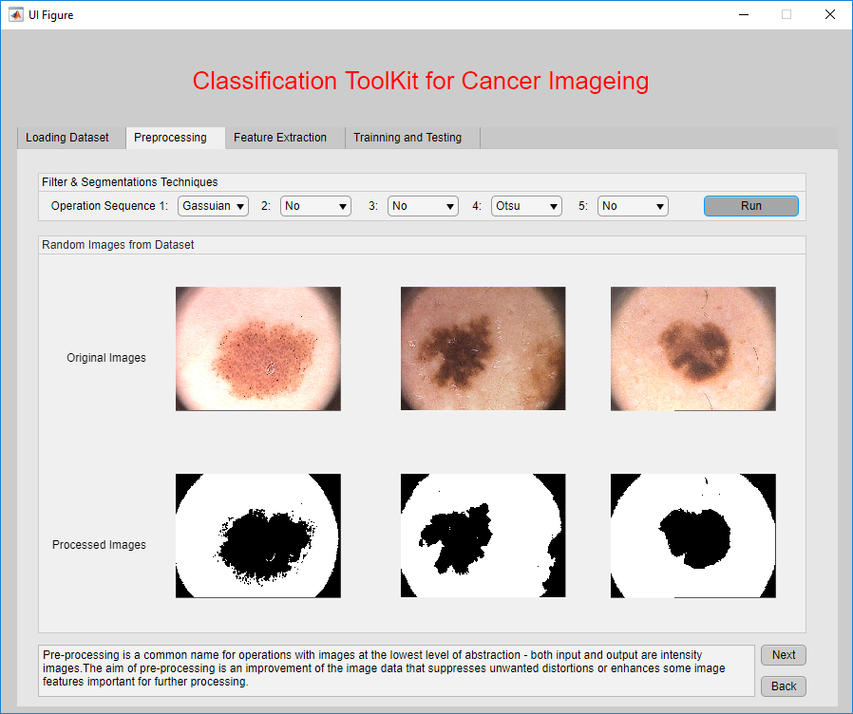
2. Preprocessing
Preprocessing
There are following preprocessing techniques are used in this module.
Filters
Gaussian Filtering
Sobel Filtering
Canny Filtering
Segmentation Techniques:
K-Means Segmentation
Otsu Segmentation

Slide 14
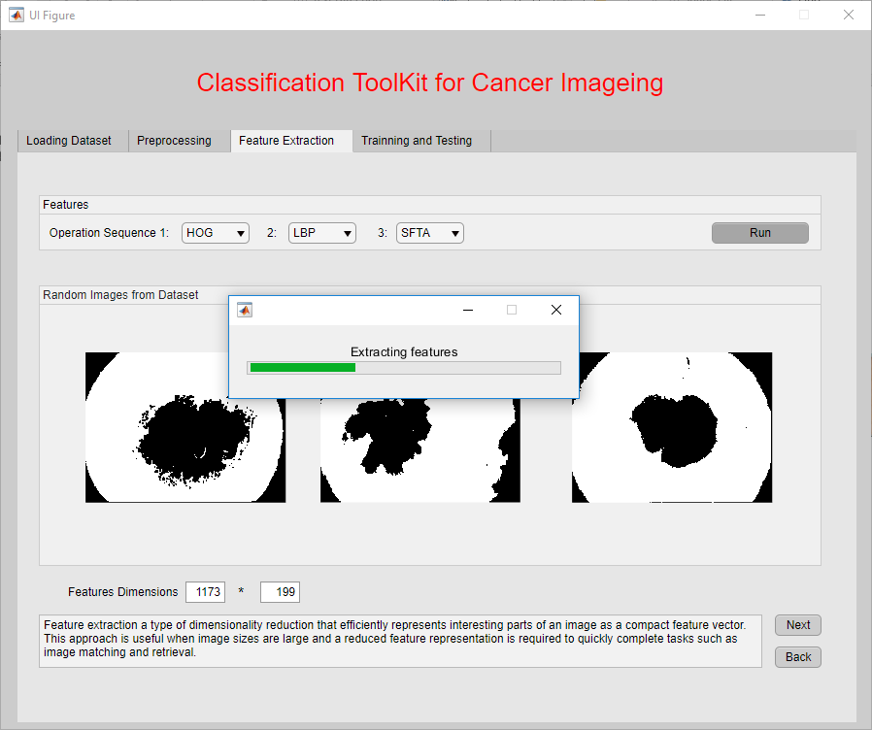
3. Features Extraction
Two types of features are extracted by this toolbox.
Hand Crafted Features
HOG Features
LBP Features
Deep Neural Networks Features
AlexNet Features
ResNet Features

Slide 15
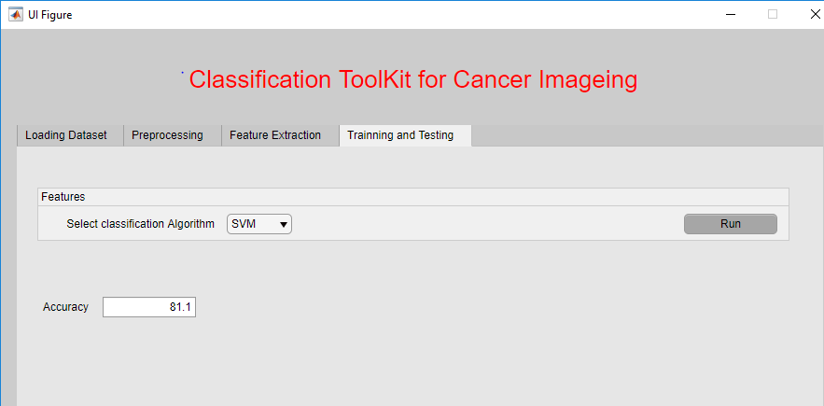
4-5. Training & Testing
There are following Classifiers can be used in this toolbox.
SVM (Support Vector Machine)
KNN (K-Nearest Neighbor)
Ensemble Method

Slide 16
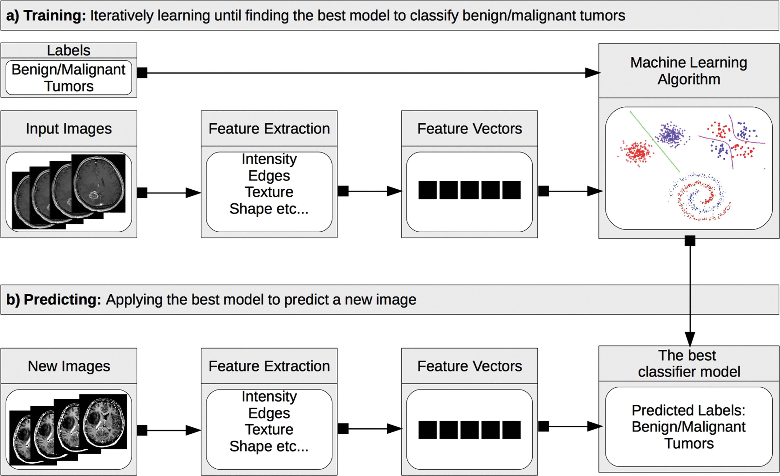
Cont..
Toolkit Flow
There is two main portion of Toolkit
Training
Predicting

Slide 17
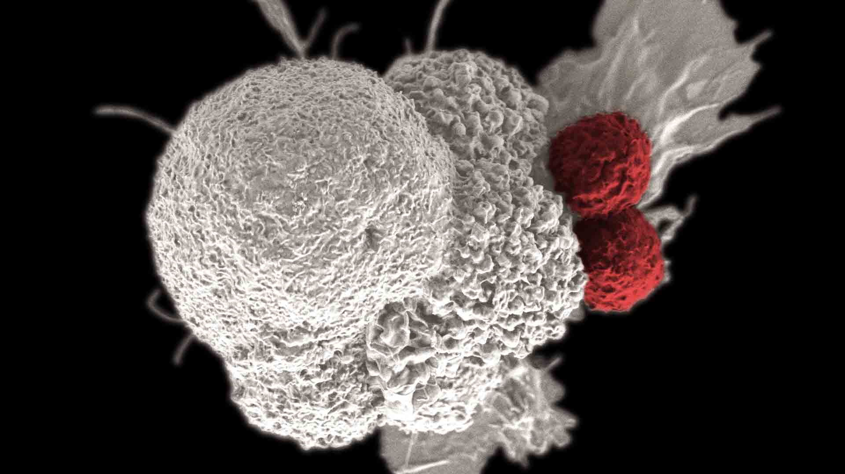
Outline
Abstract
Introduction
Literature Review
Proposed Methodology
Conclusion and Results

Slide 18
Results
We trained several datasets trained on our Toolkit it gives the following results .
Table 1: Accuracy Table along with datasets trained on out toolkit
Sr. | Datasets | Accuracy
1 | Violent Flow | 82.1%
2 | PH2 | 70.3%
3 | Cheating Detection | 89.6%

Slide 19
Conclusion
This app can be used in research projects. In future, we will add more features and new techniques for classification task.

Slide 20
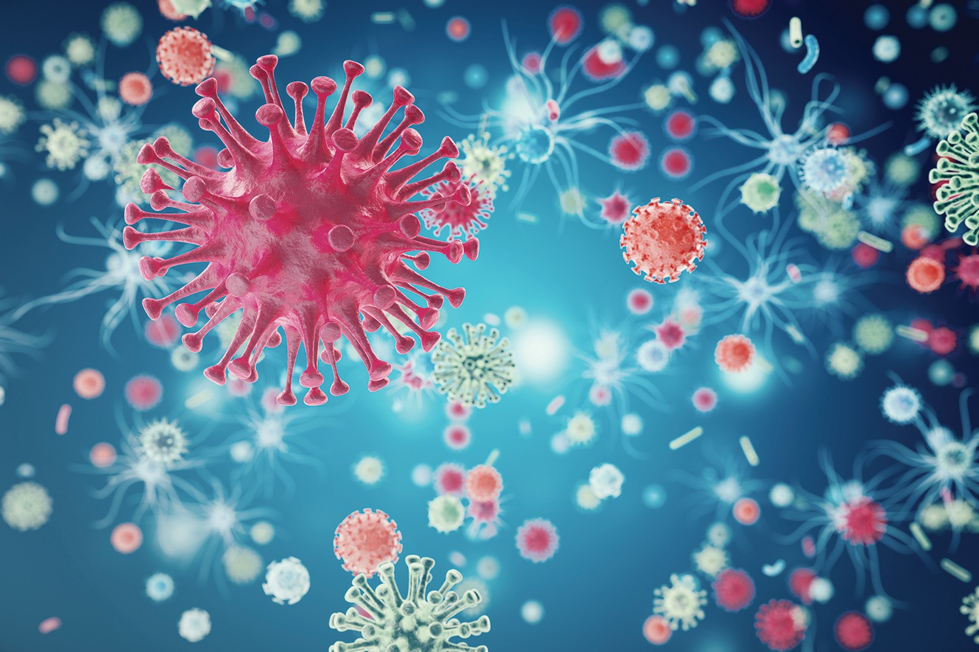
Thank You
Usman Asim & Sami Ullah

